Slide 1
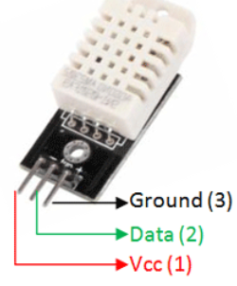
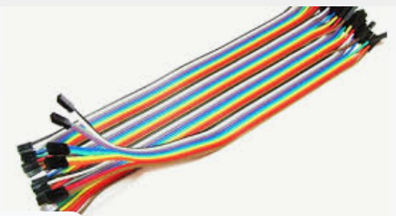
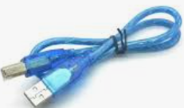
OBJECTIVE: EXPORTING DATA FROM DHT22 SENSOR INTO EXCELL SHEET!!
Components to be used:
DHT22 Sensor
Arduino uno
USB Cable
Breadboard
Connecting wires

Slide 2
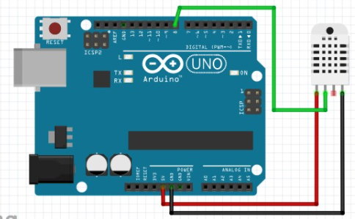
CIRCUIT DIAGRAM

Slide 3
Experiment procedures
1.Connect the circuit as shown by the above circuit diagram
2.Connect microcontroller into your PC
3.Type the Program CODE into computer connected on arduino
4.Compile and download the program into microcontroller
5. Open and configure Excell sheet using PLX-DAQ software
6. Record the measured values

Slide 4
LAB Session
Let connect the circuit diagram.

